Slide 1
MVC vs AngularJS Smackdown!

Slide 2
MVC vs AngularJS Smackdown!
What?
Compare an application written in Microsoft’s MVC tools with a Single Page Application (SPA) written with WebAPI and AngularJS

Slide 3
MVC vs AngularJS Smackdown!
Why?
Microsoft’s MVC and AngularJS both implement the Model, View Controller pattern.
One does it server side, the other does it client side.

Slide 4
MVC vs AngularJS Smackdown!
How?
So, I wrote a simple address book using both tools.
I gave myself a time box of 1 hour for each application.

Slide 5
MVC vs AngularJS Smackdown!
Demo!

Slide 6
MVC vs AngularJS Smackdown!
Comparison
MS MVC – more server processing, less dynamic interactions.
Angular – more dynamic interactions, duplication of some objects.

Slide 7
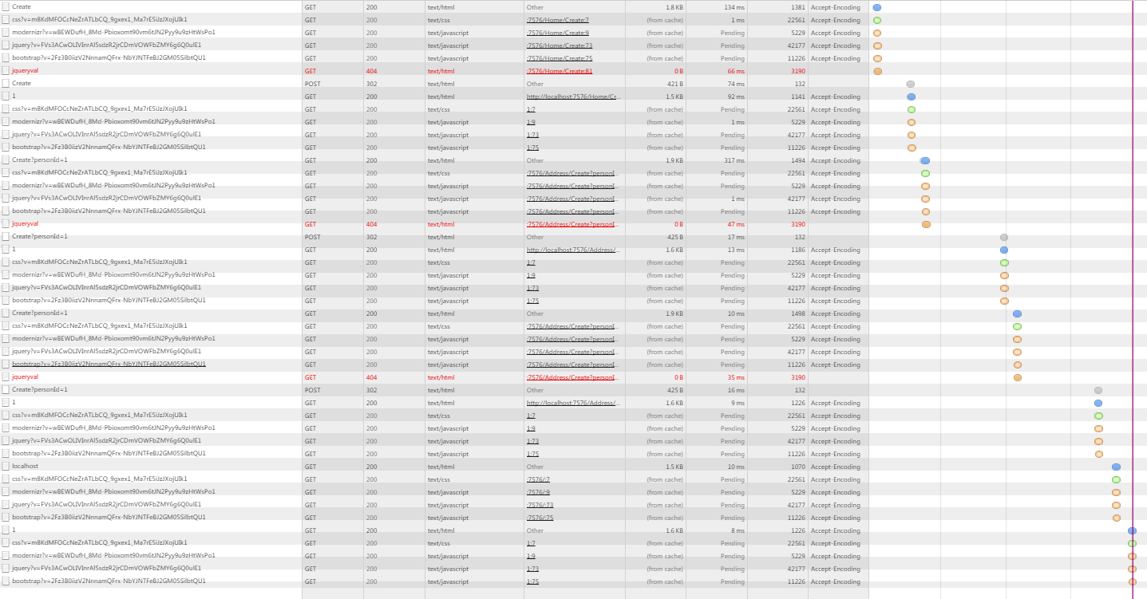
MVC vs AngularJS Smackdown!
Comparison – MS MVC Network
46 Request – 14.7KB – 687ms

Slide 8
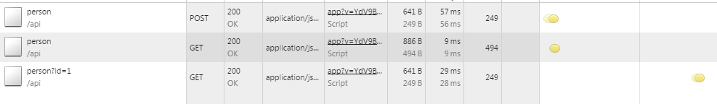
MVC vs AngularJS Smackdown!
Comparison – Angular Network
3 Request – 2.1KB – 95ms

Slide 9
MVC vs AngularJS Smackdown!
Comparison
Angular had…
175% fewer requests
150% less size
151% less bytes on the network!

Slide 10
MVC vs AngularJS Smackdown!
Final Thoughts…
If you have a simple app with no need to use Javascript, MS MVC is your friend.
Otherwise, embrace the architecture and use a Javascript framework to build your UI!

